Slide 1
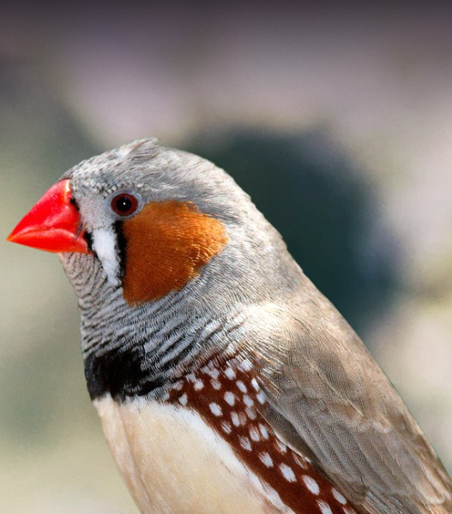
Influence of social context and age on expression of aggression in zebra finches
Anne-Laure Blanche
Katie Chenard
Renee Duckworth
Image credit: https://lafeber.com/pet-birds/species/zebra-finch/

Slide 2
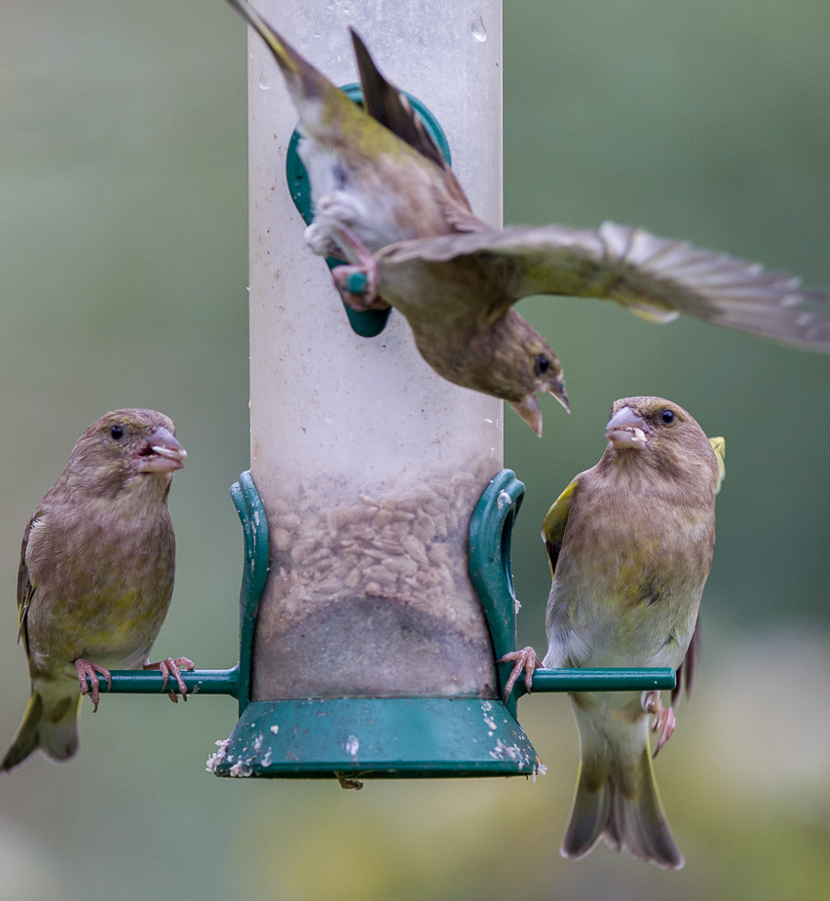
Introduction
Aggression is often highly consistent over an individual’s lifespan
However, it can only be measured in a social context
Social hierarchies are thought to be reinforced by aggressive interactions initiated by larger, older, more dominant individuals
Here, we examine whether differences in relative dominance across contexts and body size influence aggression of zebra finches when measured independently with a mirror trial
Photo credit: https://pin-sharp.blogspot.com/2014/10/aggression-at-bird-feeder.html

Slide 3
Hypotheses and Predictions
Aggression to mirror
Aggression within flock
H1. Social context does not influence aggression
Aggression is consistent across novel and stable social interactions
H2. Prior experience with social partners modulates aggression
Aggression will be different across novel and stable social interactions
H1. Dominance can contribute to access to resources and vice versa
Larger birds will be more dominant
H2. The benefits of dominance are diminished by the energetic costs of aggression
Size will have no correlation with dominance

Slide 4
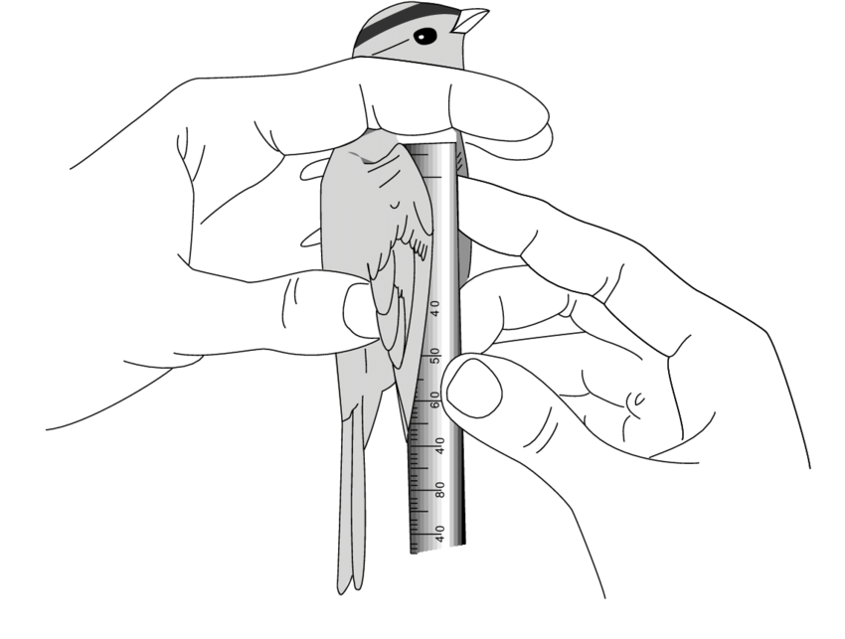
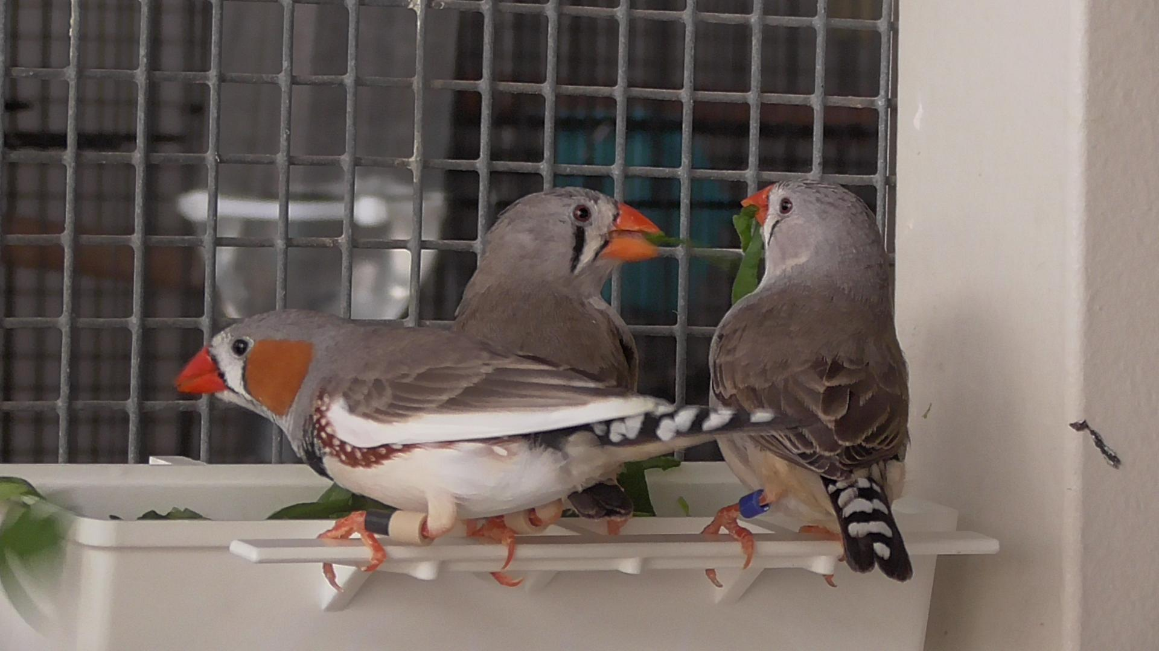
Methods
Interactions and dominance in a stable zebra finch flock were measured at a treat feeder
A mirror test mimics an unknown but equal conspecific that reciprocates visual aggression
Zebra finch measurements included tarsus length, beak length, depth, and width, wing and tail length, and body mass
Image credit: https://www.researchgate.net/figure/Above-a-good-hold-for-measuring-the-wing-chord-and-below-the-measurement-of-the-wing_fig6_253288282

Slide 5
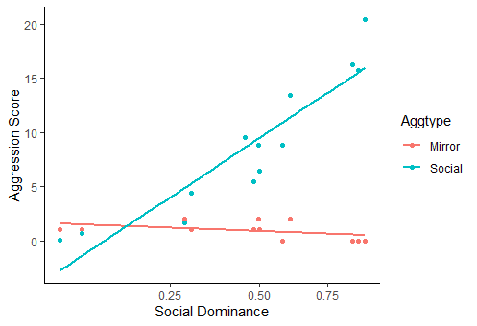
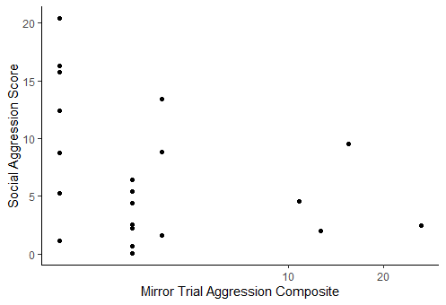
Results – within years
2018:
Zebra finches that are more aggressive in a social setting tend to be more dominant.
Mirror aggression had a slight negative trend, but overall no correlation with dominance
2019:
Aggression in a social setting was not indicative of mirror trial aggression

Slide 6
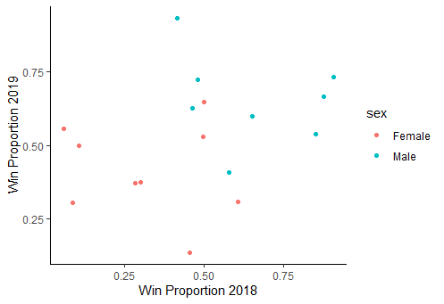
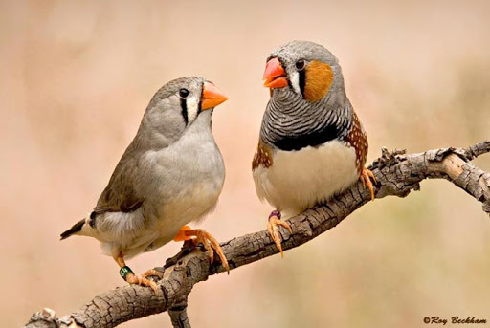
Results – across years
Social hierarchy is not stable, and dominance in 2018 did not predict dominance in 2019 for either sex.
However, males were significantly more dominant than females in both summers.
Photo credit: http://www.efinch.com/species/zebra.htm

Slide 7
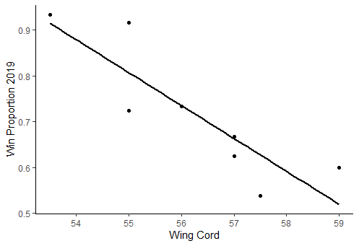
Results – size and age
Wing chord was negatively correlated with dominance in males, but there was no impact of body size on dominance on females.
Older birds (both sexes) have longer wings.
Dominance (males)

Slide 8
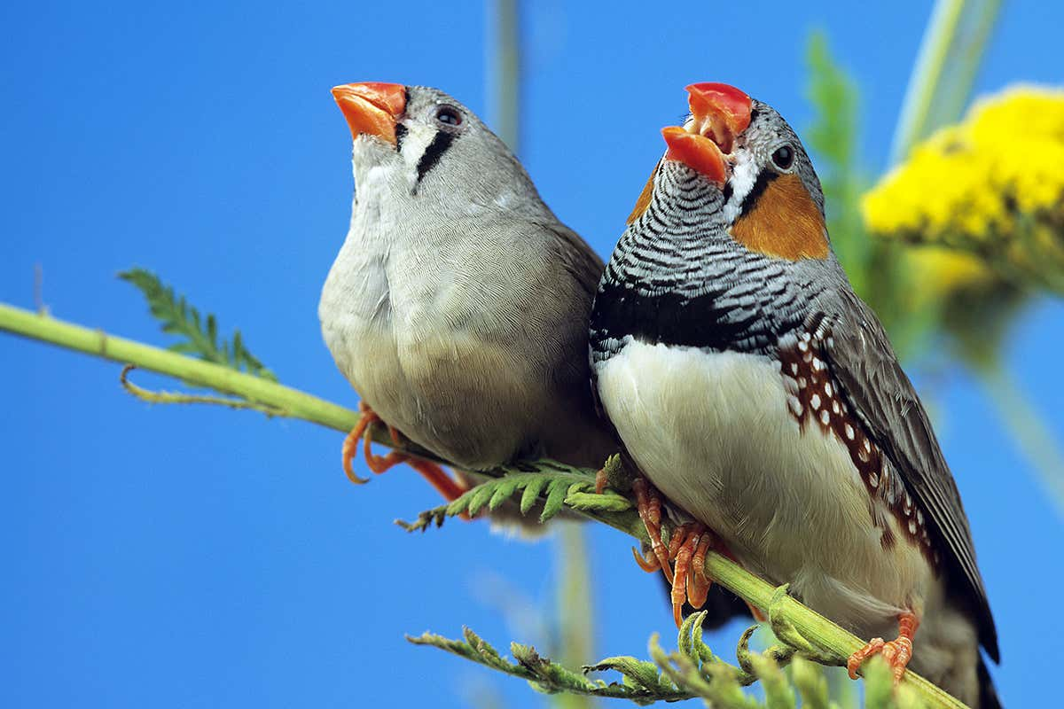
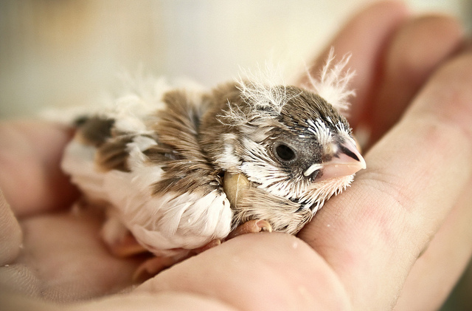
Discussion
Our results support our second hypothesis that prior experience within a social group modulates aggression, and that dominant birds are not larger.
Dominance structure in zebra finches appears to be present but fluid.
Singing or posture may skew mirror trial aggression, and a natural social context is needed to properly assess aggression
Future work could include rates of change of dominance and sensitive periods, such as courtship or breeding, as well as the impact of new fledglings or adult birds on the hierarchy
https://www.newscientist.com/article/2160842-birds-dream-sing-by-moving-their-vocal-muscles-in-their-sleep/
https://www.singing-wings-aviary.com/zebrafinches.htm

