Slide 1
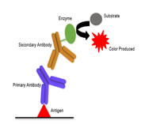
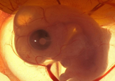
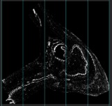
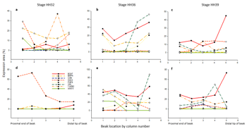
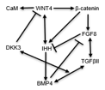
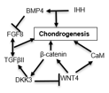
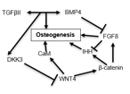
CHANGING CO-EXPRESSION OF TRANSCRIPTION FACTORS ACROSS SPACE AND TIME DURING DEVELOPMENT
Max J. Gleason, Sarah E. Britton, Cody A. Lee, Renee A. Duckworth, Alexander V. Badyaev
Department of Ecology and Evolutionary Biology
Abstract:
During development, morphological change requires interaction between molecular genetic regulators and physical processes, integrating cell proliferation and differentiation. Transcription factors (TFs) are a set of highly conserved genetic regulators expressed across tissue types. The differential co-expression of transcription factors across developmental stages can explain tissue transformation and morphological outcome. Thus, the combinatorial nature of development allows for tissue specificity and morphological diversity despite the conservation of regulators. In this study, we develop a system for the study of transcription factor co-expression in multiple tissue types during avian craniofacial development. Using embryonic tissue samples from common house finch we quantify the expression of eight transcription factors across five stages of development. Here, we present our framework and a progress report of this work.
Figure 5. Area of Interest. Following photography of upper and lower beak sections, areas of specific interest are cute out for analysis. This is where we are currently working. These areas of interest will then be analyzed for a degree of expression seen in the next figure. This is important to the process because it eliminates portions of the photographs which are not being analyzed in this project and keeps only the tissues desired.
Figure 2. Protein detection methods. (a) house finch embryos were staged, preserved and cryosectioned. (b) Immunohistochemistry (IHC) uses antibodies to specific protein antigens to visualize location of proteins. (c) IHC protocols were developed and optimized for eight transcription factors across late stages of development. Shown are areas of expression for IHH (top), β-catenin (middle) and a control (bottom) at stage HH39.
Figure 6. Photomicroscopy methods. Photography using standardized settings was followed by color deconvolution using Fiji to separate the stain of interest. Each image was thresholded and split into five equal columns. Transcription factor expression was recorded as percentage of each column in order to provide overall expression area as well as localized expression data.
Hypotheses:
Hypothesis 1: If functional co-expression of TFs is equivalent to network structure, then all functionally related factors will be expressed together throughout development. Hypothesis 2: If functionality depends on activation and inhibition processes, then functionally related TFs will be expressed sequentially. Hypothesis 3: If functionality depends on persistence of certain factors but activation/inhibition of others, then some TFs will be expressed throughout development while others will be expressed sequentially.
Figure 3. Cellular level expression of transcription factors (40x). (a) Cytoplasmic CaM expression in muscle tissue surrounded by unstained cartilage. (b) Cytoplasmic IHH expression in cartilage and nasal epithelial tissue. (c) β-catenin expressed in nuclei of mesenchymal cells and cytoplasm of epithelial cells.
Figure 1. Transcription factor networks. (a) Network of biochemical pathways connecting eight target TFs. (b-c) Functional associations of TFs in relation to tissue differentiation. Target TFs include beta-catenin (β-catenin), bone morphogenic protein 4 (BMP4), calmodulin (CaM), dickkopf homolog 3 (DKK3), fibroblast growth factor 8 (FGF8), Indian hedgehog (IHH), transforming growth factor beta two (TGFβII), and wingless type 4 (WNT4).
Figure 4. H&E staining. (a) Outline showing major tissue types stained by H&E. (b) Five late embryonic stages showing tissue transformation, highlighting the developing Meckel’s cartilage (green frame) and internasal cartilage (yellow frame).
Figure 7. Changing spatial and temporal expression of transcription factors. (a-c) Upper beak percent area of TF expression, stages HH32, HH36 and HH39. (d-f) Lower beak percent area of TF expression, stages HH32, HH36, and HH39.

