Slide 1
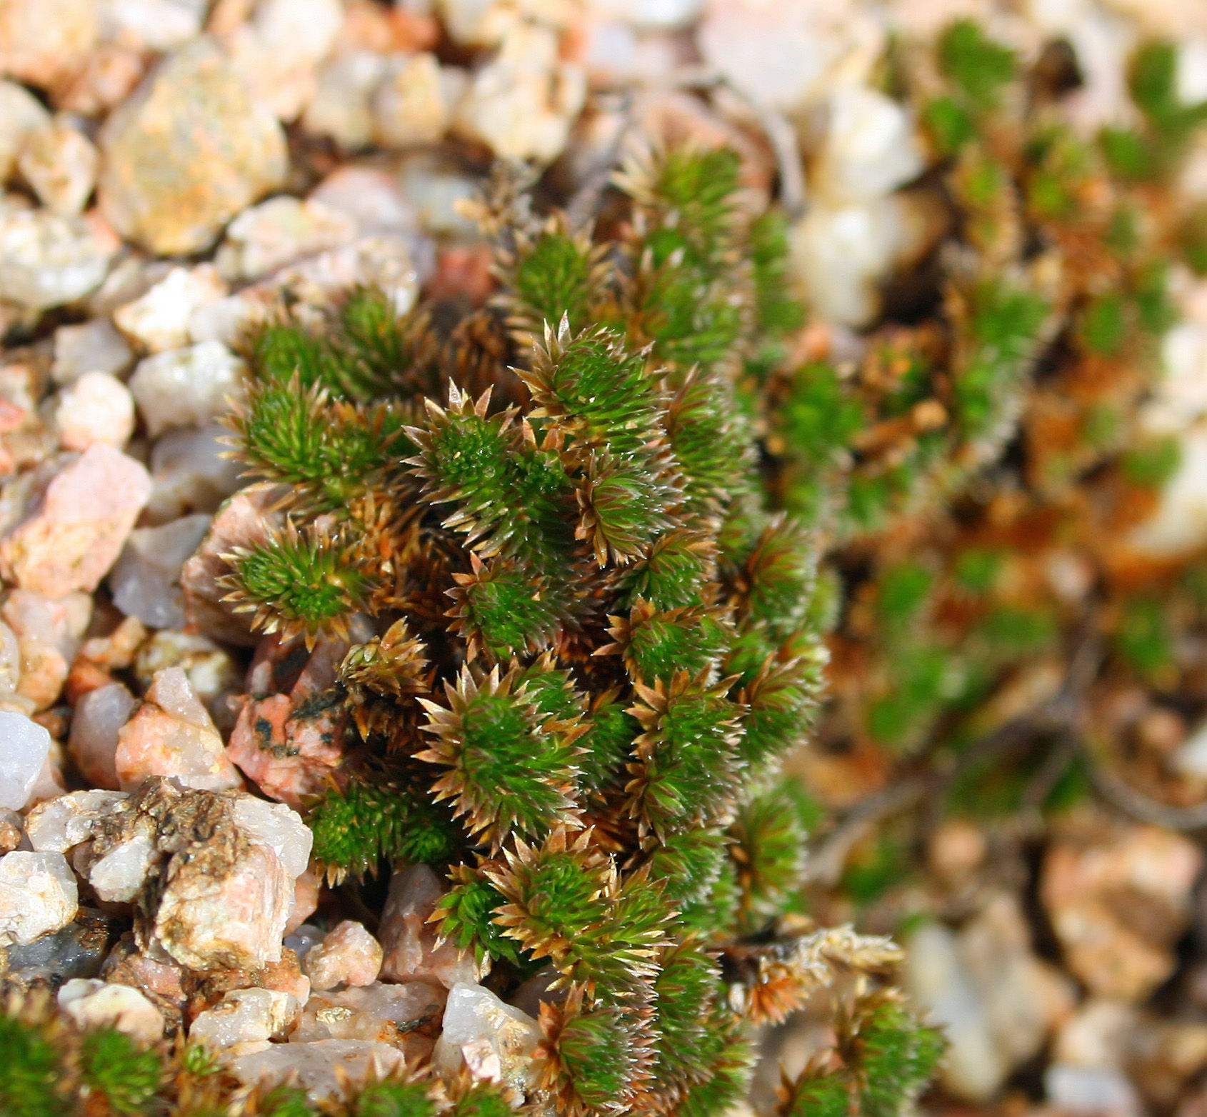
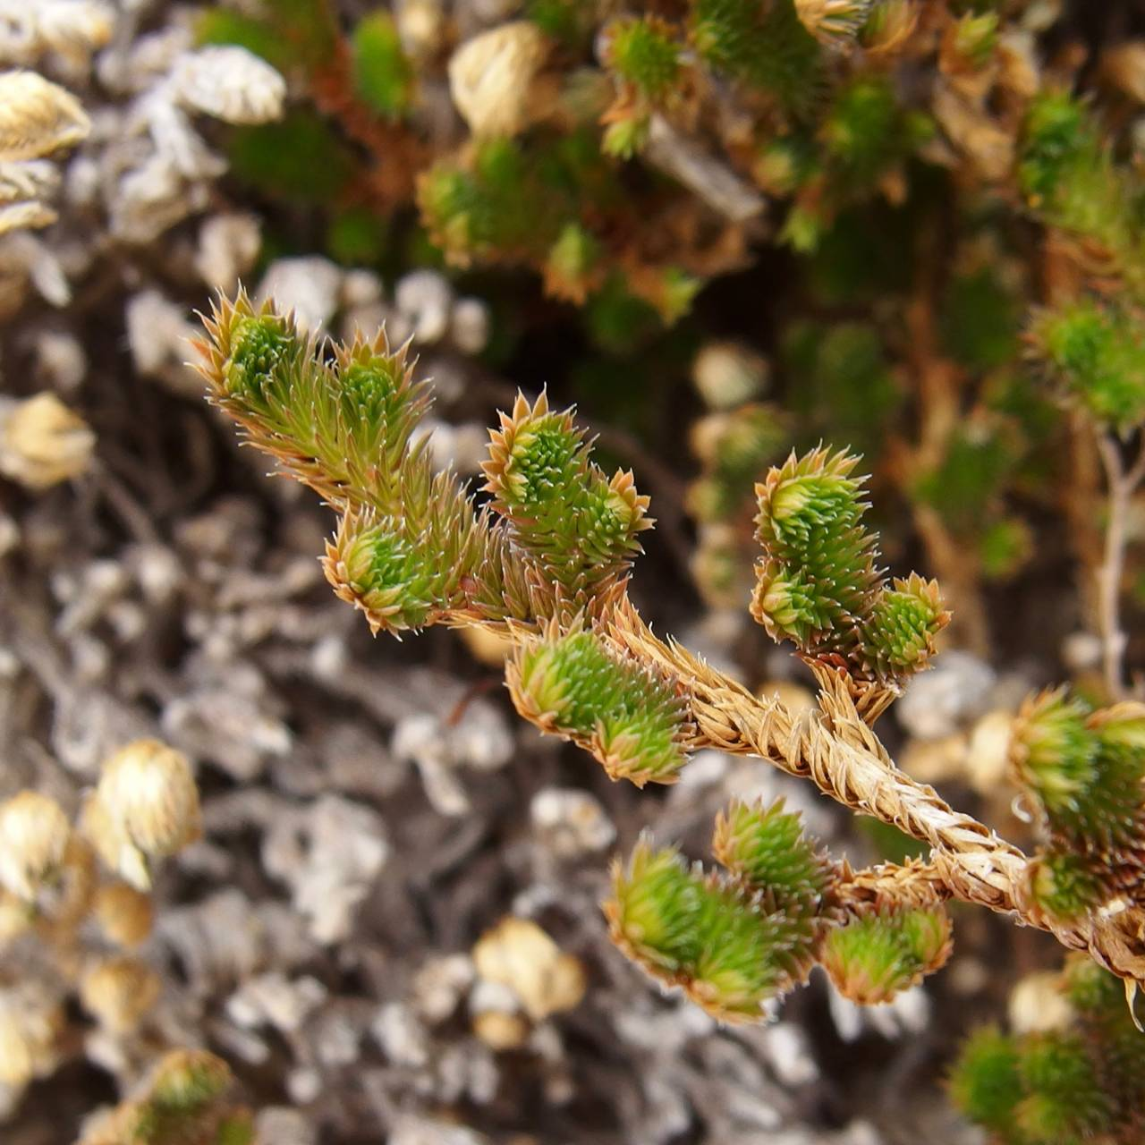
Selaginella arizonica
Objective: This plant mainly lives in the desert climate environment, we can study the local climate change through the development of desert plants. To explore the optimal growth environment of this plant, and to reflect the influence of external conditions on its growth.
Instructor: Peter Chesson
Student: Shizhe Li
Selaginella arizonica is a kind of plant that lives in rock or land and mainly lives in rock crevices or gravel. Its stem is not easy to crack and it grows in a creeping or vertical way. Mainly in Arizona, Texas and Mexico.
Methods
1. Different soil types and watering frequencies
2. Take photos of plants regularly
3. Using computer software to analyze and calculate the vegetation of the plants in the photos for measurement
In addition, we will make field visits to the local environment, collect soil samples, analyze soil properties, and combine with recent weather conditions. We will then use statistical techniques, such as regression and correlation analysis, to analyze the data based on the data obtained from the experiment.

