Slide 1
Are stress granules essential for TDP-43 aggregation/toxicity?
Luke Nero
Buchan Lab

Slide 2
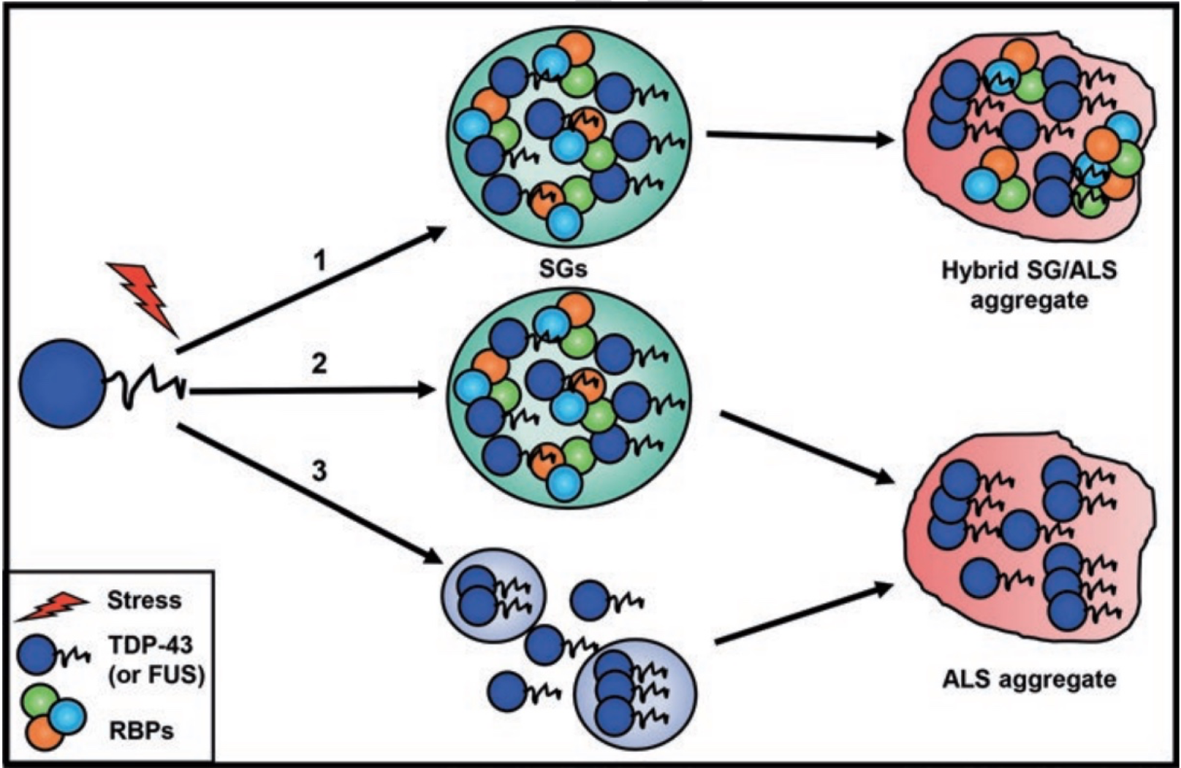
Background
Hallmark of ALS is mislocalization and aggregate formation of the protein TDP-43
Debated whether these aggregates are toxic
TDP-43 seen to localize in stress granules (SGs) in human cells, along with other RNA binding proteins (RBPs)
SGs hypothesized to be aggregating sites of TDP-43

Slide 3
SG Experiment

Slide 4
Foci formation does not correlate with toxicity

Slide 5
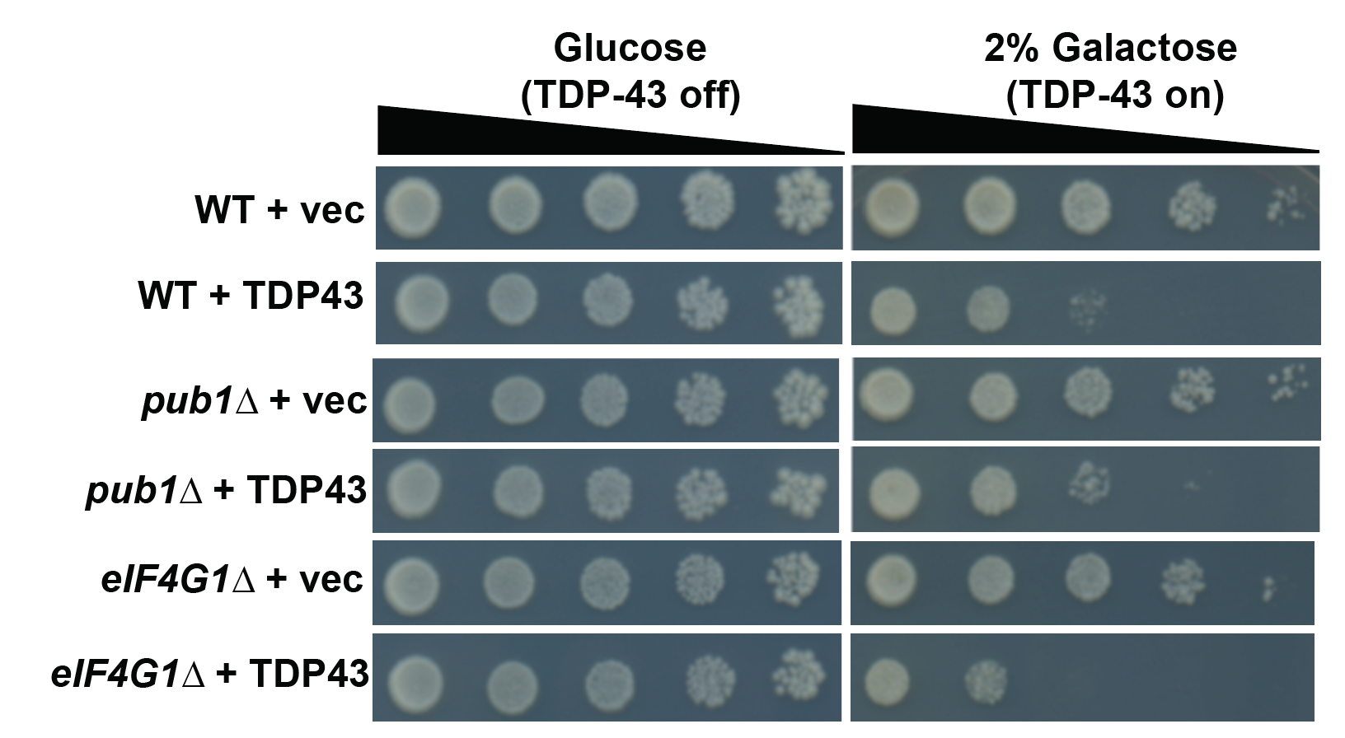
Foci formation does not correlate with toxicity

Slide 6
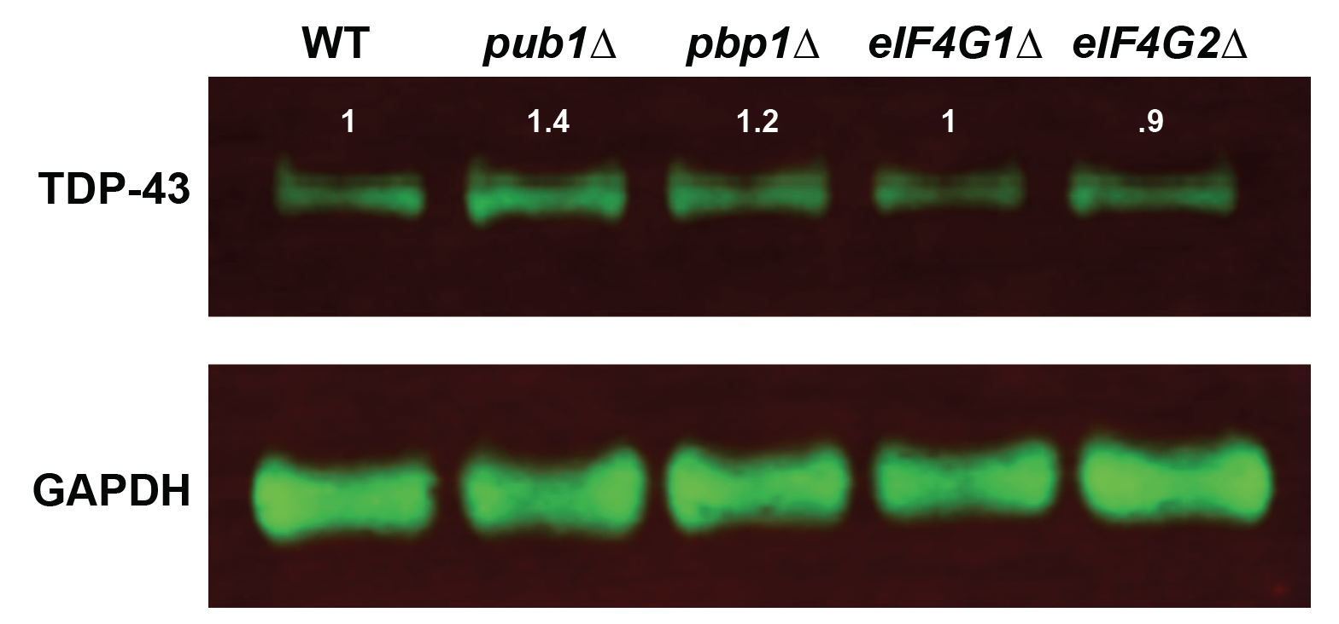
SG mutants exhibit similar TDP-43 levels

Slide 7
SG mutants in mammalian cells
SG mutants in yeast model unclear. Are there trends in a mammalian cell model?
U2OS SG mutants from Anderson lab
dG3BP1/dG3BP2 (referred to as ggdd)

Slide 8
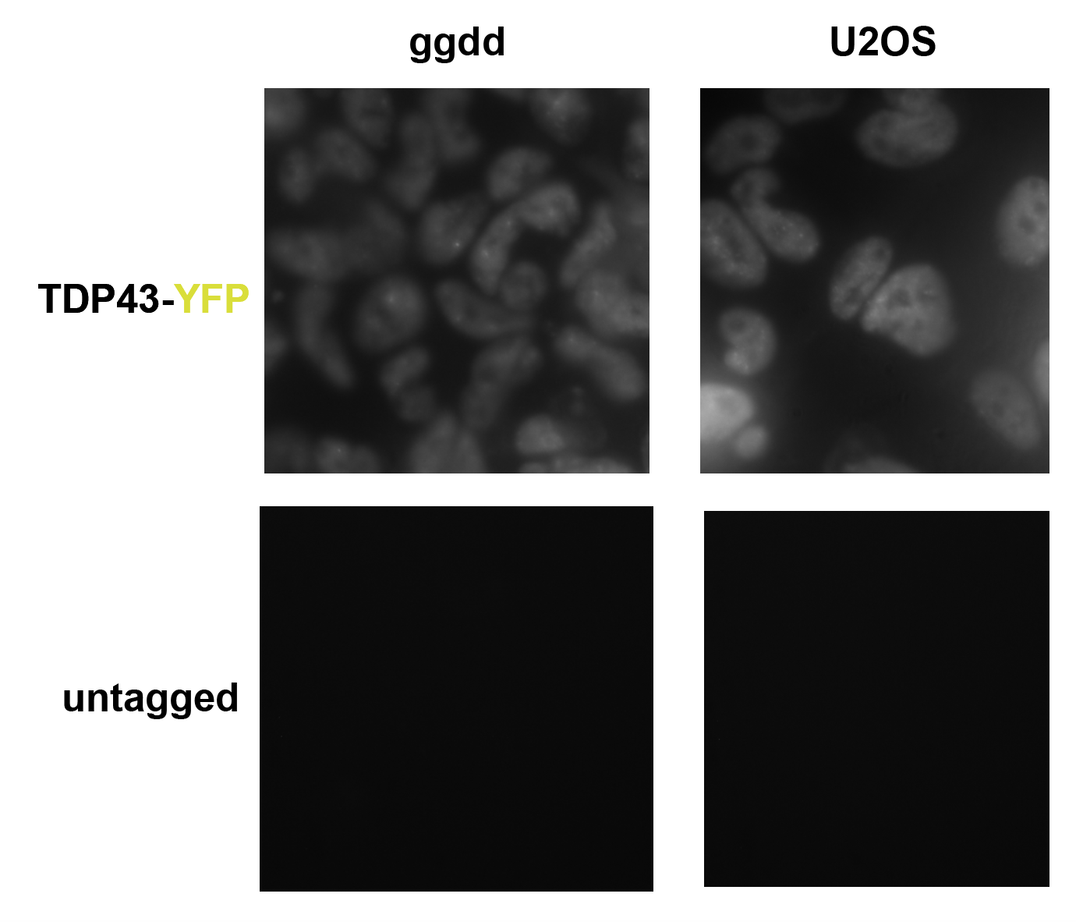
Tag TDP-43 in WT and ggdd
Successfully CRISPRd YFP tag onto C-terminus of endogenous TDP-43 in U2OS and ggdd cell lines

Slide 9
How do TDP-43 foci differ under unstressed and stressed conditions?

Slide 10
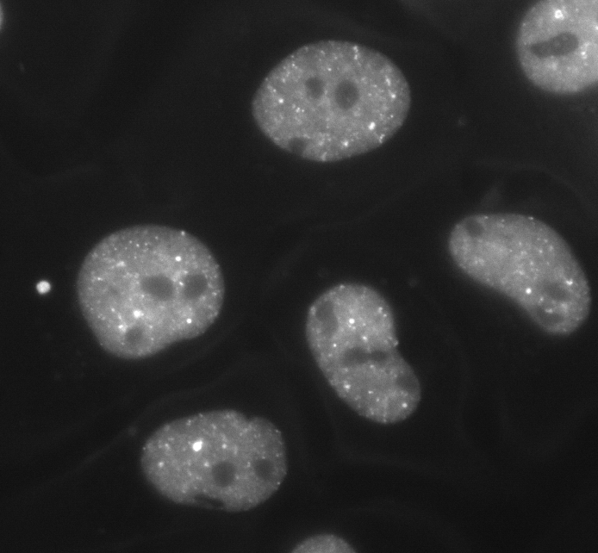
Unstressed
U2OS
ggdd

Slide 11
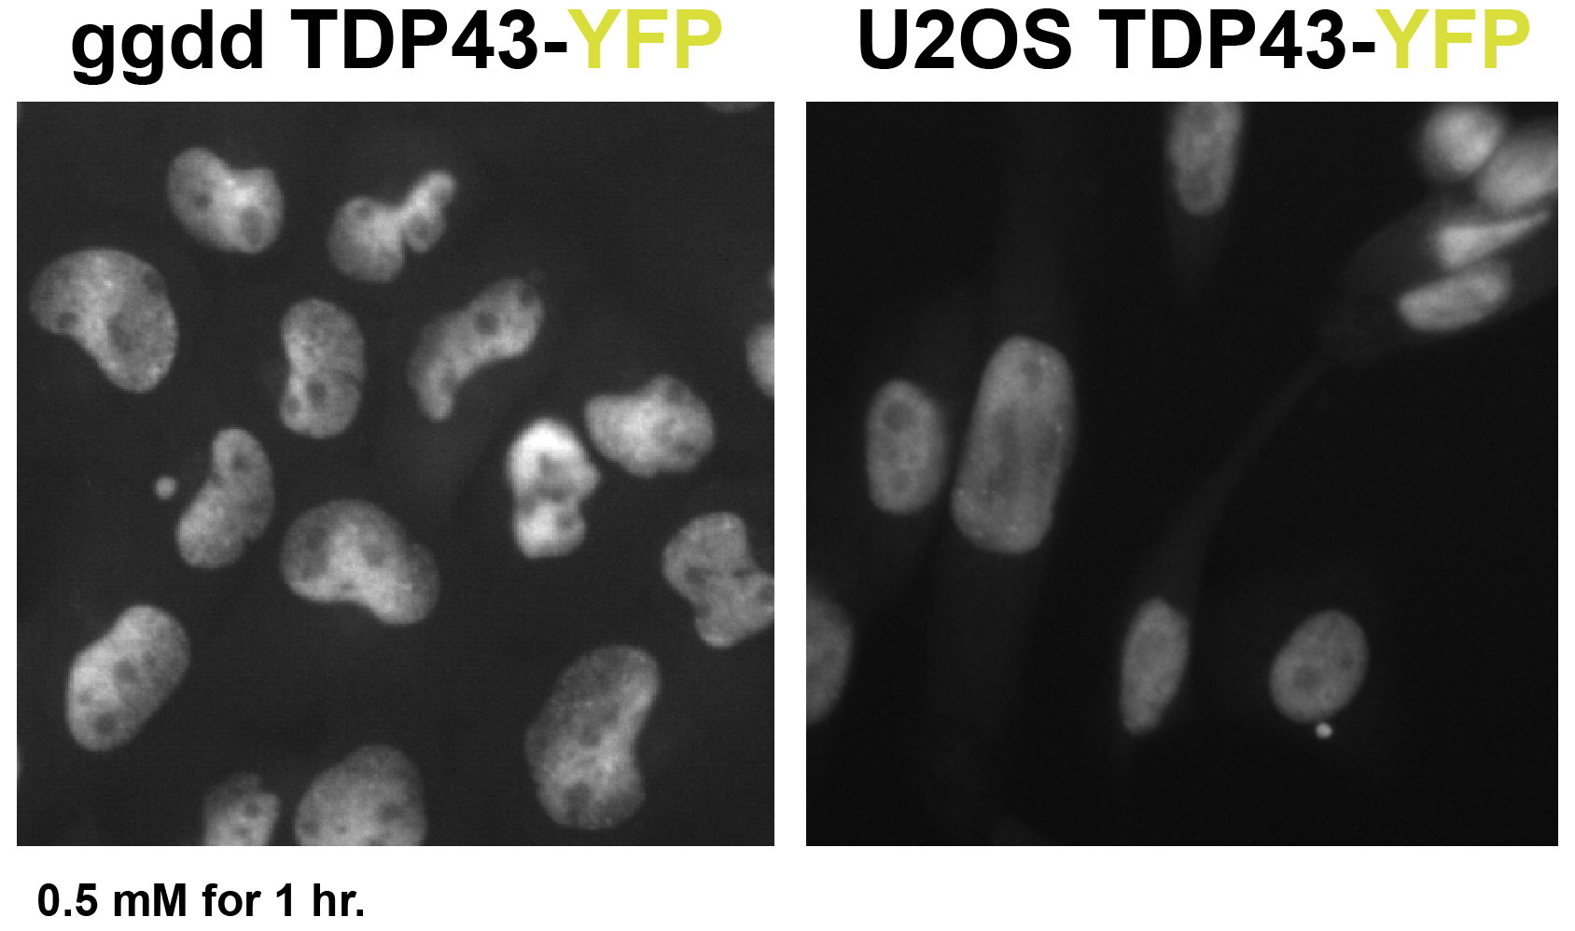
Stressed

Slide 12
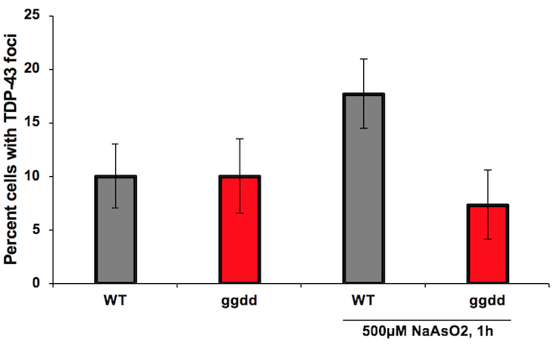

Slide 13
Future Directions

Slide 14
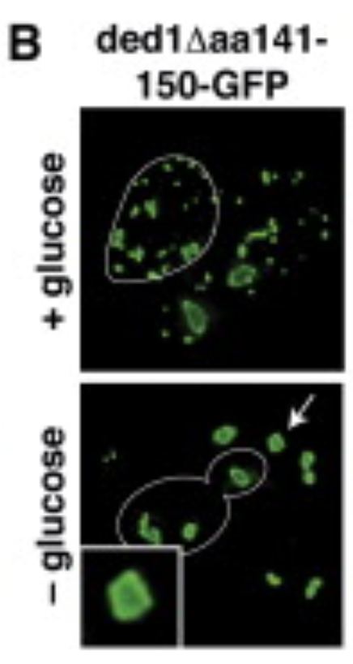
Can TDP-43 aggregation be driven by SG component overexpression?
Ded1 ATPase mutants drive the assembly of constitutive SGs
Overexpression plasmids
Growth assays
Microscopy

Slide 15
Acknowledgements
Bolger Lab
Anderson Lab
Buchan Lab
Ross Buchan
Nikita Fernandes
Nichole Eshleman
Aaron Byrd
Eman Basha
Keith Aspinall
Amanda Warner
Hassan Chamas
Sophia Franco
Abel Cherian

