Slide 1
How Does BLH6 Regulate XIP1?
Katerina Sacoman
Notes:
I am interested in how the BLH6 transcription factor regulates the expression of the receptor kinase XIP1. What kind of plant sciences am I interested in. How plants respond to the environment.

Slide 2
Introduction
CEP perceived by XIP1
(CEPR1) and/or CEPR2
CEPs travel to shoot
Induces CEP peptides
Plants have a signaling system in which roots that are not getting enough Nitrogen can send out a long-distance signal to the shoot.
The XIP1 receptor (CEPR1) regulates lateral root initiation.
BLH6 binds to the promoter region of XIP1, based on yeast-1 hybrid screen.
Up-regulation of
nitrogen transporters
on side with available
nitrogen
Low nitrogen in one side
of root system
BLH6 protein
XIP1 promotor
Notes:
One signaling system is when there are low levels of nitrogen on one side of the roots and high levels of nitrogen on the other side. To understand more about how XIP1 works, the yeast 1 hybrid was used to find transcription factors that bind there and BHL6 was found.
The way this works is by putting a promotor in a yeast cell in front of a reporter gene and then expressing transcription factors that might bind the promoter, thereby activating the reporter gene.

Slide 3
Hypothesis and predictions
H1
H1. BLH6 promotes XIP1 expression in the phloem H2. BLH6 represses XIP1 in cell types in which it is repressed
BLH6 is predicted to be a repressor
H2

Slide 4
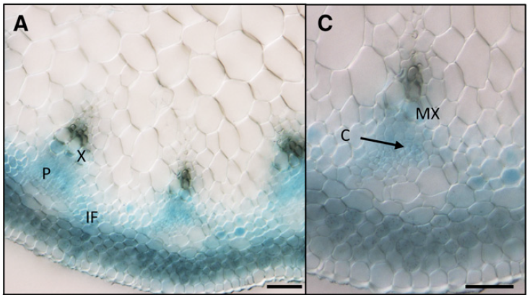
BLH6
BLH6 is expressed in the stems of the plants.
BLH6 is expressed in the phloem like XIP1, but also the interfascicular bundles as well.
Phloem
Cambial region
Interfascicular fibers
Image credit: BEL1-LIKE HOMEODOMAIN6 and KNOTTED ARABIDOPSIS THALIANA7 Interact and Regulate Secondary Cell Wall Formation via Repression of REVOLUTA
Notes:
BLH6 is very interesting to the

Slide 5
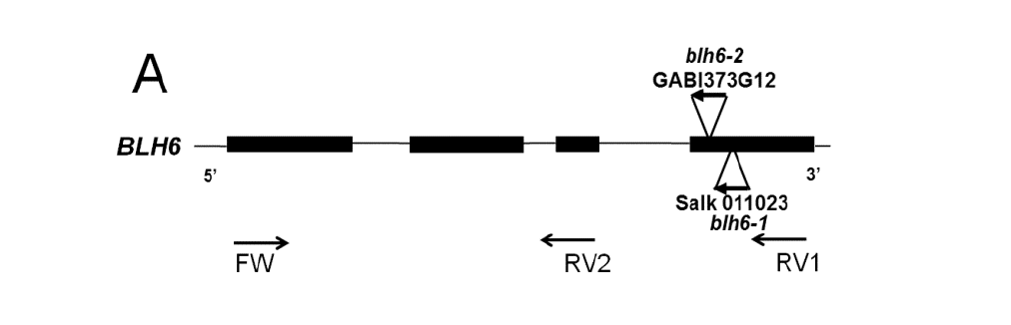
Methods
Image credit: BEL1-LIKE HOMEODOMAIN6 and KNOTTED ARABIDOPSIS THALIANA7 Interact and Regulate Secondary Cell Wall Formation via Repression of REVOLUTA
What I am doing: Crossing T-DNA insertion mutants into the promoter line.
Do DNA extractions to identify mutant and wild type bands using PCR and running gels.
Image credit :https://www.researchgate.net/figure/The-exponential-amplification-of-DNA-in-PCR_fig4_236065209
Notes:
Insertions that we are studying FW and RV are gene specific primers. Using gene specific primers only gets big band and using gene specific and TDNA primers gets a smaller band. DNA fragment in red primers are grey and they help us to make more copies

Slide 6
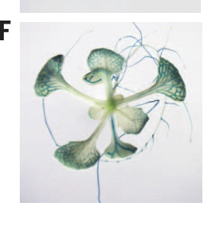
Results
Wild Type
Mutant
My gel shows that some plants have the mutation, so we cross them into the GUS reporter line
Because we crossed pollen from pXIP1::GUS into the blh6 mutants, we can stain the leaves of the F1 generation. We found blue leaves in the next generation, so the cross worked.
Direction of movement
Image credit: Perception of root-derived peptides by shoot LRR-RKs mediates systemic N-demand signaling
Notes:
Mutant band is smaller. Genotyping plants before we cross them

Slide 7
Discussion
One more generation of plants is needed to evaluate my hypothesis.
Once homozygous mutants that express the GUS reporter are found, I will slice up the stems of the plants to examine reporter staining and stem structure.
I predict that BLH6 is a repressor
Image credit: BEL1-LIKE HOMEODOMAIN6 and KNOTTED ARABIDOPSIS THALIANA7 Interact and Regulate Secondary Cell Wall Formation via Repression of REVOLUTA

