Slide 1
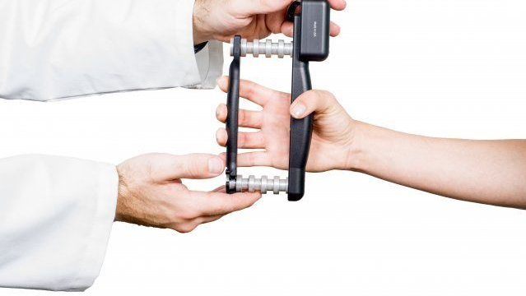
RESULTS OF A 6-WEEK INSPIRATORY MUSCLE STRENGTH TRAINING INTERVENTION ON HANDGRIP STRENGTH IN HEALTHY ADULTS
Photo credit: https://www.prohealthcareproducts.
com/commander-echo-grip-dynamometer-starter-kit/
Sarah M. Schwyhart, E. Fiona Bailey, PhD, Claire M. DeLucia, MS, Dean Debonis, BS

Slide 2
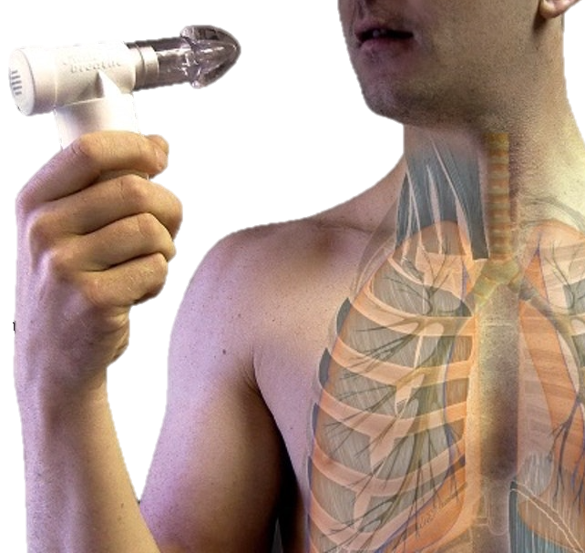
INTRODUCTION
Inspiratory muscle strength training (IMST) increases respiratory muscle strength after 6 weeks^{1, 2}
Handgrip strength has been shown to correlate with respiratory muscle strength³
Handgrip strength has been found to be at least a moderate indicator of overall strength (i.e., functional capacity)⁴
Little research has focused on how IMST affects functional capacity
Photo credit: https://www.physio-pedia.com/Respiratory_Muscle_Training
Notes:
I’d like to begin by giving some background on inspiratory muscle strength training, also known as IMST. IMST has been shown to increase respiratory muscle strength after merely 6 weeks. Interestingly, respiratory muscle strength has also been shown to be correlated with handgrip strength. It has been reported that inspiratory loading significantly increases the contraction force of the adductor pollicis (AP), a muscle in the hand that adducts the thumb, compared to muscle contractions performed during non-loaded breathing. Similarly, IMST has been associated with increased limb muscle strength. Limb muscle strength, including handgrip strength, has been shown to be an indicator of overall body strength, also called functional capacity, in younger individuals. However, not much research has been done on the effect IMST has on functional capacity.

Slide 3
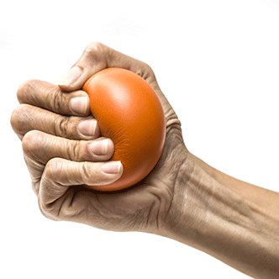
STUDY PURPOSE
The present study developed and tested the impact of 6 weeks of IMST on functional capacity via the assessment of handgrip strength
Photo credit: https://www.cardiosmart.org/News-and-
Events/2015/05/Strong-Grip-Indicates-Better-Heart-Health
Notes:
In this study, we assess the potential for 6 weeks inspiratory muscle strength training to improve respiratory endurance and in turn, functional capacity

Slide 4
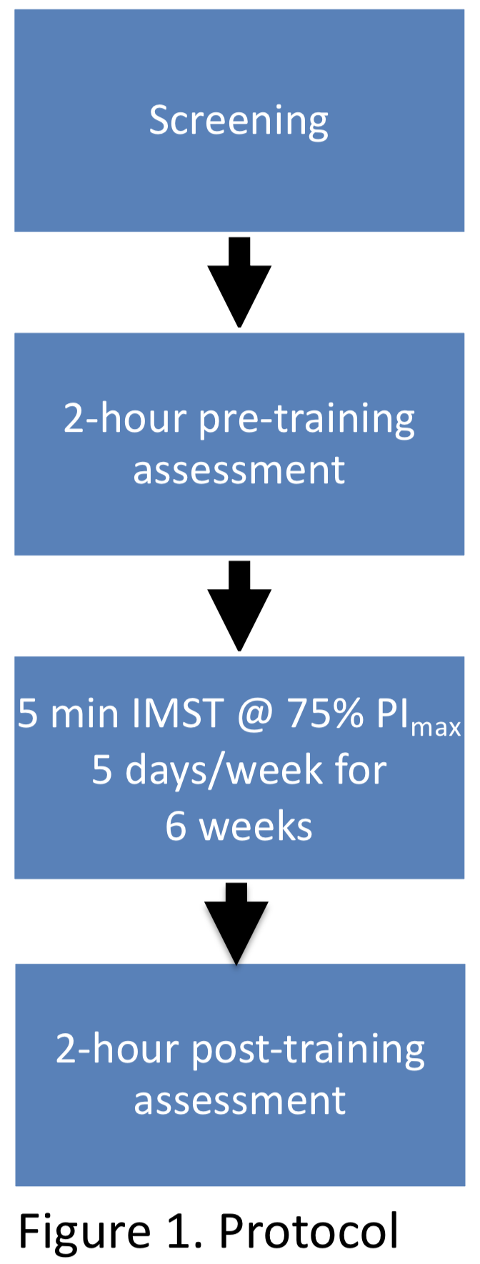
METHODS
The study was conducted from 09/26/19 – 12/13/19
Recruitment via community-based methods
IMST protocol over 6 weeks + pre- and post-assessments
Subjects performed 2 grip tasks, 1 before and 1 after a respiratory task during the pre- and post-assessments
Grip tasks were performed at 35% of maximal voluntary contraction (MVC)
Respiratory task was performed at 65% of maximal inspiratory pressure (PI_{max})
Respiratory strength (PI_{max}), respiratory endurance (sec), grip strength (N) and grip endurance (sec) were assessed at intake and at 6 weeks
Notes:
Data was collected over 4 months from August 26th to December 13th, 2019. The study protocol is outlined in Figure 1. Subjects initially participated in a familiarization session to become comfortable with the procedures and instrumentation and to determine their eligibility. Subjects who completed screening and were eligible for inclusion then returned to the laboratory and underwent the following procedures: 1) a 2-hour pre-training assessment; 2) 5 minutes of IMST, 5 days a week for 6 weeks, and 3) a 2-hour post-training assessment.
For the respiratory endurance task, subjects were instructed to place their mouth on a two-way non-rebreathing valve fitted with flow limitation end cap on the inhalation port and an attached mouthpiece. Subjects performed three maximal inspiratory breaths with a 30 s rest period in-between trials. The highest inspiratory pressure recorded was used as their maximum and to calculate their target pressure of 65% of their maximal inspiratory pressure, known as PI_{max}. After the target pressure was obtained, subjects began the fatigue task. Subjects were instructed to breath on the valve at their target pressure for as long as possible, or until they fatigued. Respiratory endurance was measured as time, in seconds, until fatigue.
Subjects were also asked to perform a submaximal grip task before and after the respiratory endurance protocol for purposes of evaluating static endurance handgrip strength. To calculate maximal grip strength, subjects were required to grip a hand dynamometer, a device that measures strength, as hard as they can for 5 seconds and then repeated two more times. The highest force recorded during the three trials was used as the maximal voluntary contraction (MVC) and to calculate the target submaximal grip force, set at 35% of their MVC. After the target force was obtained, subjects began the grip task. Subjects were instructed to grip the hand dynamometer at their target force for as long as possible, or until they fatigued. Grip endurance was measured as time, in seconds, until fatigue.
Respiratory strength, respiratory endurance, grip strength and grip endurance were all assessed at intake and at week 6.

Slide 5
RESULTS: PARTICIPANT CHARACTERISTICS
7 participants were recruited through The University of Arizona (Table 1)
Notes:
Seven healthy young adults (5 men and 2 women) were recruited from The University of Arizona through the use of flyers and in-person presentations in lectures and laboratory courses to participate in this study. Prior to the initiation of the study, all participants gave their written informed consent.
Anthropomorphic data for our seven participants are presented in Table 1, including mean age, height, weight and body mass at intake. Subjects were nonsmokers, without a history of hypertension, respiratory, cardiovascular or neuromuscular disease, and with a forced expiratory volume to forced vital capacity ratio $≥$ 80%. All reported exercising on a regular basis (3-5 times/week for ~60 minutes) and reported maintaining the same activity levels throughout the study. All subjects completed the intervention and thus, the retention rate for this study was 100% (7 of 7 subjects).

Slide 6
RESULTS: GRIP & RESPIRATORY STRENGTH
Male and female subjects showed an increase in respiratory muscle strength (P < 0.001) at week 6 (Table 2)
There was no significant effect of IMST on maximal grip strength (P = 0.08) at week 6 (Table 2)
Notes:
As shown in Table 2, following 6 weeks of IMST, all participants had made steady gains in their inspiratory muscle strength reflected in a 41% increase in PI max by study close. A statistically significant difference was found between respiratory strength in pre- vs post-assessments.
Grip strength (N) was found to increase slightly by 18.02 N from pre training to post training, but was not statistically significantly.

Slide 7
RESULTS: GRIP & RESPIRATORY DURATION
There was no effect of IMST on grip duration (P = 0.13)
IMST increased respiratory duration (P = 0.01)
Figure 1. Individual pre-/post-training grip durations
Figure 2. Average individual pre-/post-respiratory endurance task
grip durations
Notes:
Grip endurance, or duration, decreased after both the respiratory endurance task and 6 weeks of training compared to pre-assessment values. Grip duration also decreased after respiratory endurance grip tasks (as shown in Figure 2), and after 6 weeks of training (Figure 1). There was no statistically significant difference between grip duration in pre vs post assessments.
Respiratory endurance or duration, increased significantly by week 6. A statistically significant difference was found between respiratory endurance prep vs post-training.

Slide 8
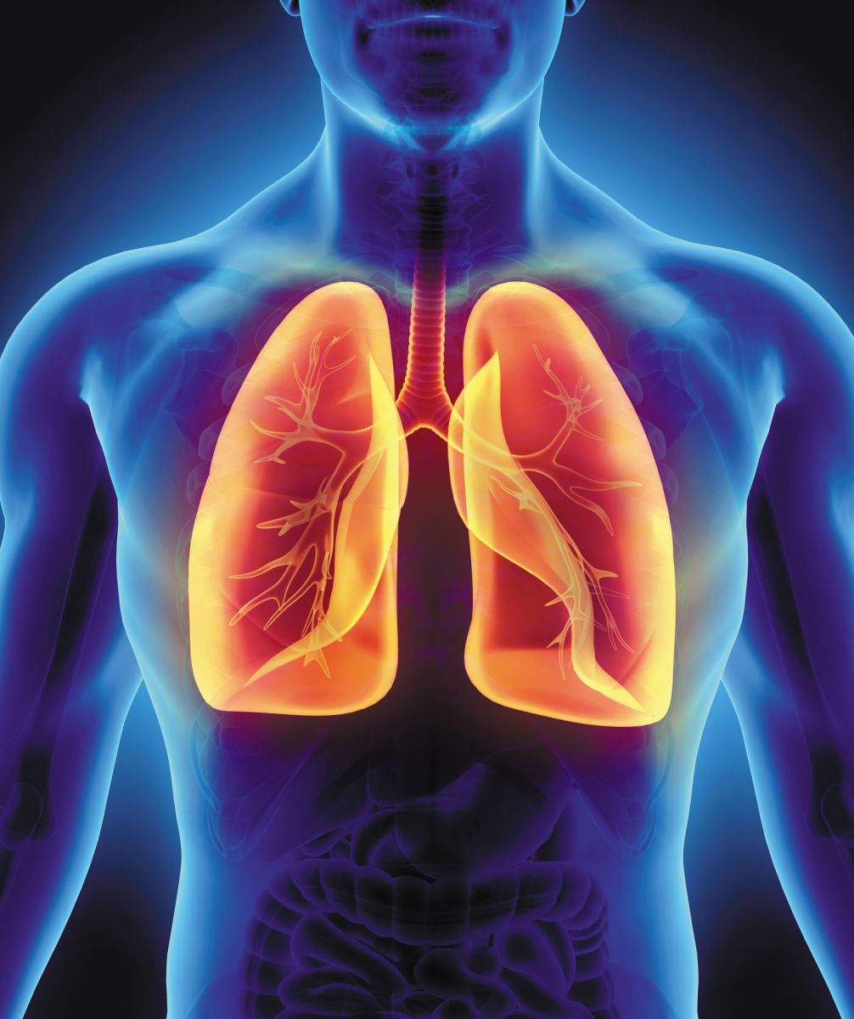
DISCUSSION
IMST improved both respiratory strength and respiratory endurance (duration), providing additional support to previous literature
Contrary to our prediction, IMST did not significantly improve grip strength or grip duration
Photo credit: https://www.health.harvard.edu/lung-
health-and-disease/breathing-life-into-your-lungs
Notes:
A statistically significant difference was found between respiratory strength pre- vs post-training, as well as between respiratory endurance pre- vs post-training. This result provides support for previous literature that has found that IMST improves respiratory strength.
However, there was no statistically significant difference between grip strength or grip endurance pre- vs post-training. Contrary to previous literature, no significant correlation was found between respiratory strength and grip strength. IMST was not found to affect grip strength, and since grip strength has been found to be an indicator of functional capacity, our results suggest that functional capacity is not related to inspiratory loaded breathing.

Slide 9
LIMITATIONS
We had a small sample size which limited our statistical power
COVID-19 negatively affected our ability to complete our study with additional participants
Lack of standardization between and within subject protocols
Notes:
Limitations of our study include that we had a small sample size, which limited our statistical power. We were unable to complete trainings of current participants due to COVID-19. A lack of standardization in the protocol across subjects may have affected our results, as well as a possible lack of standardization in the protocol within subjects during pre vs post assessments, such as a change in instruction, encouragement, or electromyographic (EMG) placement on skin overlying the muscles of interest.

Slide 10
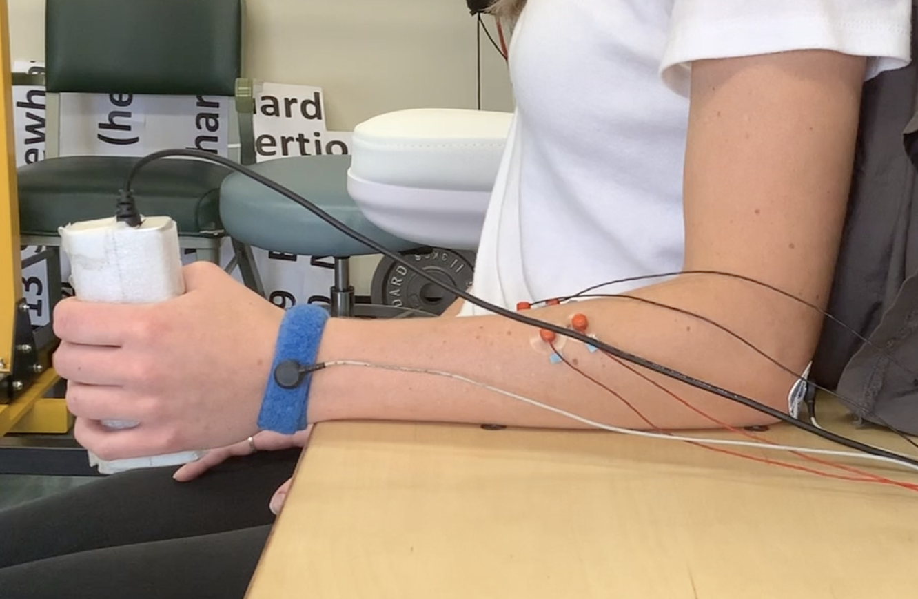
NEXT STEPS
Conduct additional trials to increase sample size
Standardize subject protocols to better isolate forearm muscles of interest
Examine different limb muscles
Notes:
Further work is necessary to determine if IMST affects functional capacity. Moving forward, we hope to conduct additional trials to increase our sample size and get a better idea of the impact IMST has on grip strength and functional capacity. During these additional trials, we plan to determine ways to better standardize within and between-subject protocols to ensure our results are accurate. Additionally, it would be interesting to isolate different limb muscles, including different muscles in the arm, as well as muscles in the leg to see if a different result is observed.

Slide 11
REFERENCES
Sasaki M., Kurosawa H., Kohzuki M. Effects of inspiratory and expiratory muscle training in normal subjects. J. Jpn. Phys. Ther. Assoc. 2005;8:29–37. doi: 10.1298/jjpta.8.29.
Huang CH, Yang GG, Wu YT, Lee CW. Comparison of inspiratory muscle strength training effects between older subjects with and without chronic obstructive pulmonary disease. Journal of the Formosan Medical Association 2011;110(8):518-26.
Efstathiou ID, Mavrou IP, Grigoriadis KE. Correlation between maximum inspiratory pressure and hand-grip force in healthy young and middle-age individuals. Respir Care. 2016;61:925–929.
Ishizaki, T., Watanabe, S., Suzuki, T., Shibata, H., & Haga, H. (2000). Predictors of functional decline among nondisabled older Japanese living in a community during a 3-year follow-up. Journal of the American Geriatrics Society, 48(11), 1424-1429.

